Slide 1
Lecture 18

Slide 2
Question 223.17.3
I have two lenses placed with a separation of 1m to form an optical system. The focal length of the combined system is…..
25cm
f₁ + f₂
f₁ x f₂
No simple relationship

Slide 3
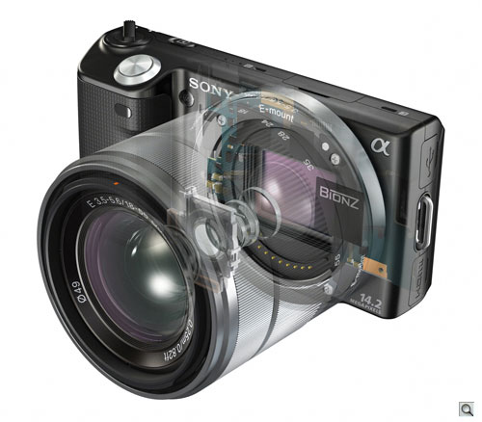
http://www.imaging-resource.com/PRODS/NEX5/NEX5A.HTM

Slide 4
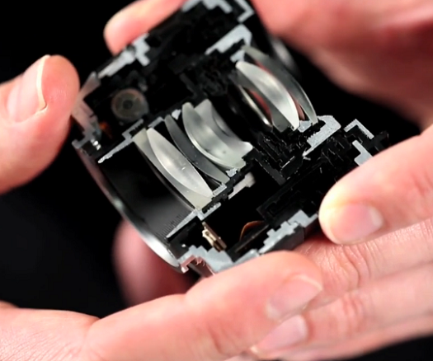
http://sonyalphanex.blogspot.com/

Slide 5
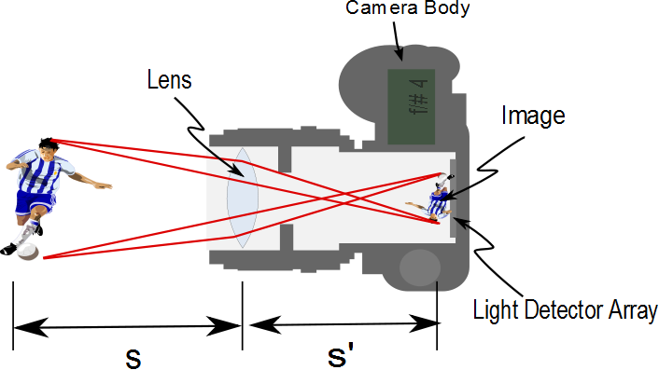
Aperture

Slide 6
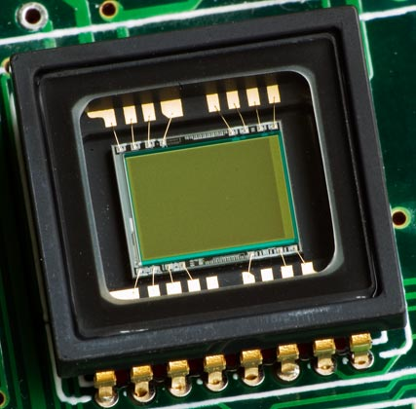

Slide 7
Question 223.17.4
For a camera, usually the object distance is large. If that is true, about how big is the image distance?
About 10cm
About as big as the focal length
About as big as the diameter of the lens
About as big as the object

Slide 8
Question 223.17.5
For a camera, usually the object distance is large. If that is true, what can we say about the image size?
It’s 10cm
It is proportional to the focal length
It is proportional to the diameter of the lens
Nothing

Slide 9
Question 223.17.6
For a camera, usually the object distance is large. What can we say about the intensity of the light that strikes the focal plane array?
It’s 10²cm
It is proportional to the focal length squared
It is proportional to the diameter of the lens squared
Nothing squared

Slide 10
Question 223.17.6.5
For a camera, will a larger or a smaller aperture let in more light?
Larger
Smaller
Impossible to tell

Slide 11
Question 223.17.7
What does the f/# tell you?
It gives you a relative intensity measurement
It tells you how large your lens is
It tells you how flat your focal plan array is
Still nothing

Slide 12
http://hubblesite.org/the_telescope/hubble_essentials/graphics/telescope_essentials_howworks2_lg.gif

Slide 13
Question 223.18.4
What is the power (in Diopters) of a lens with a focal distance of 0.5m?
5
4
3
2
1

Slide 14
Simple Magnifier
A simple magnifier consists of a single converging lens
This device is used to increase the apparent size of an object
The size of an image formed on the retina depends on the angle subtended by the eye

Slide 15
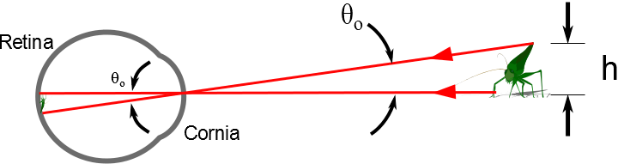

Slide 16
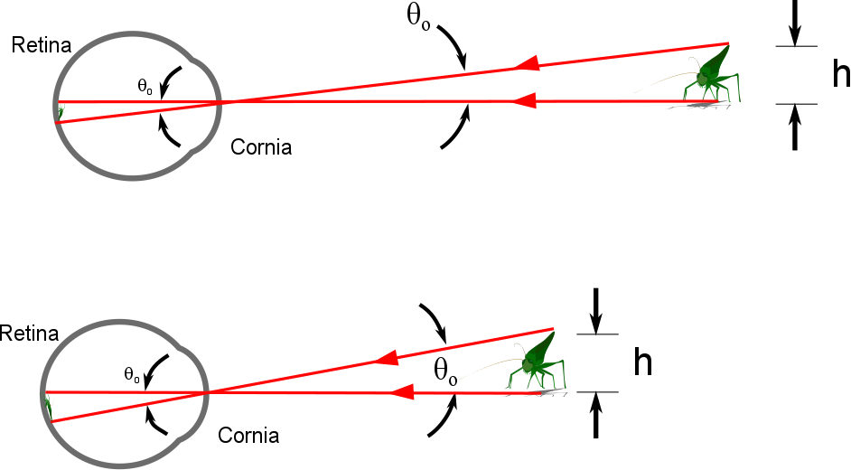

Slide 17
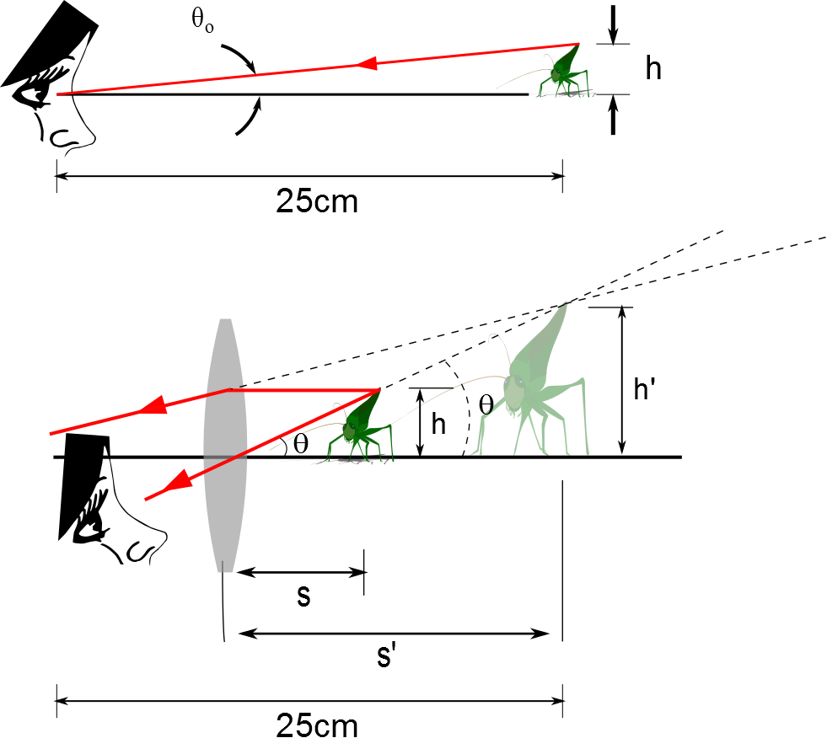
The Size of a Magnified Image
When an object is placed at the near point, the angle subtended is a maximum
The near point is about 25 cm
When the object is placed near the focal point of a converging lens, the lens forms a virtual, upright, and enlarged image

Slide 18
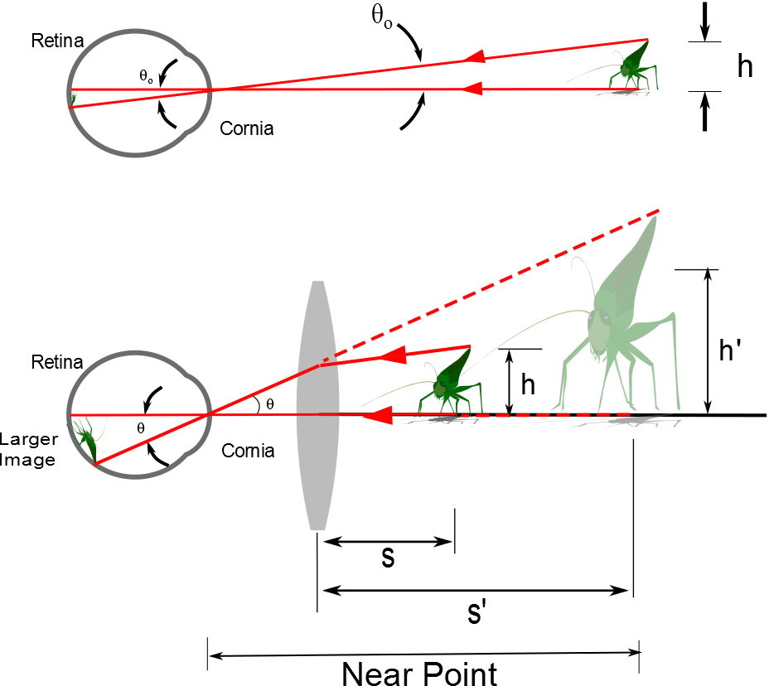
d

Slide 19
Angular Magnification
Angular magnification is defined as
The angular magnification is at a maximum when the image formed by the lens is at the near point of the eye
s’ = - 25 cm
Calculated by

Slide 20
Angular Magnification, cont.
The eye is most relaxed when the image is at infinity
Although the eye can focus on an object anywhere between the near point and infinity
For the image formed by a magnifying glass to appear at infinity, the object has to be at the focal point of the lens
The angular magnification is

Slide 21
Magnification by a Lens
With a single lens, it is possible to achieve angular magnification up to about 4 without serious aberrations
With multiple lenses, magnifications of up to about 20 can be achieved
The multiple lenses can correct for aberrations

Slide 22
END

Slide 23
Question 223.18.1
Two campers wish to start a fire during the day. One camper is nearsighted and one is farsighted. Whose glasses should be used to focus the Sun’s rays onto some paper to start the fire?
either camper
the nearsighted camper
the farsighted camper

Slide 24
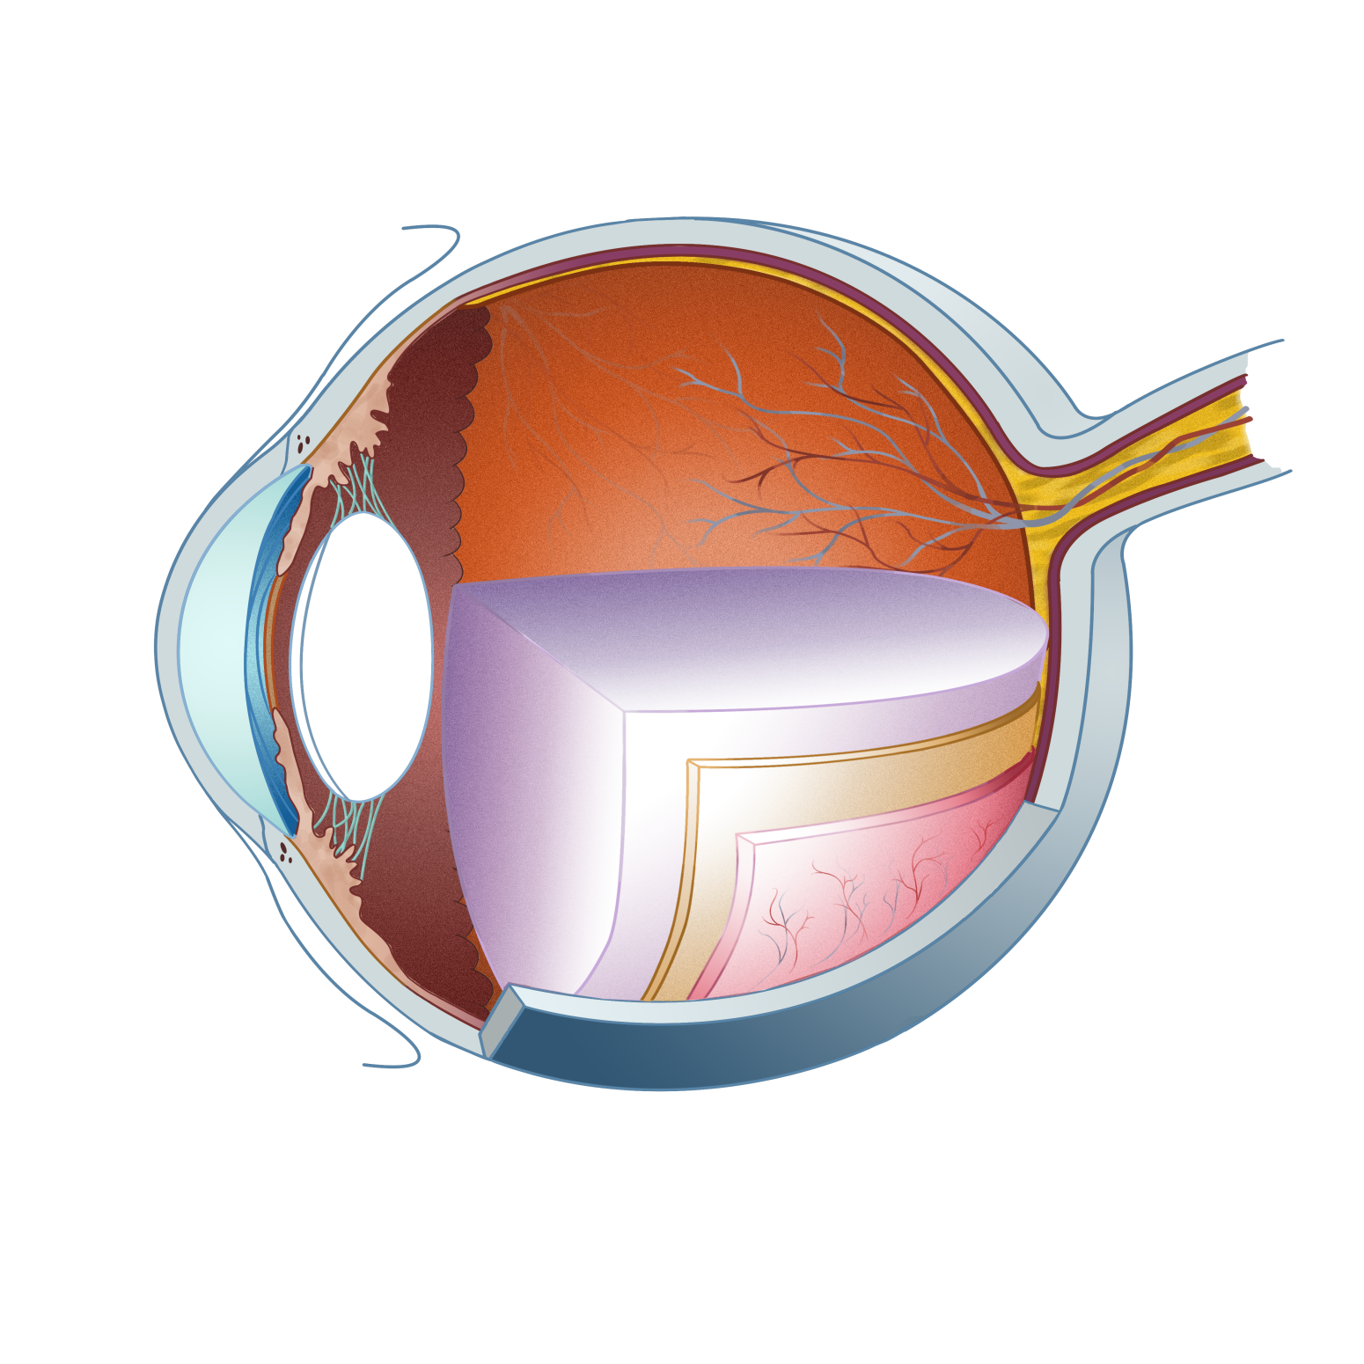
Vitreous humor
Lens
Aqueous humor
Pupil
Irisl
Cornea
Retina

Slide 26
Question 223.18.2
What do biologists call the process of focusing the light in the eye?
focusing
accommodation
image formation
Contraction of the ciliary muscle

Slide 27
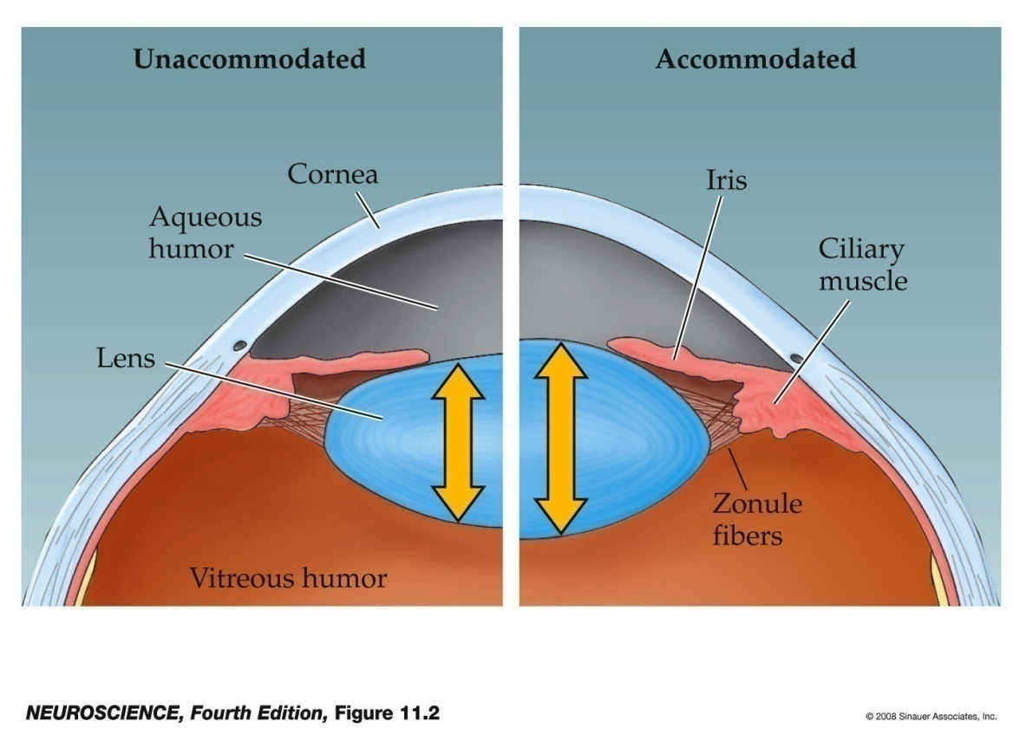
Accommodation by the Lens
Accommodation refers to dynamic changes in the shape of the lens.
As an object comes within about 20 feet the light rays originating at a point are no longer considered to be parallel.
Rather these light rays diverge and a greater refractive power is required to bring them into focus.
The lens can contribute about 12 or more diopters to the focusing of light rays on the back of the eye by rounding up.
Notes:
neuro4e-fig-11-02-0.jpg

Slide 28
Question 223.18.3
What do we call the position of the closest thing we can see?
Near point
Far point
Squint point
conjunctiva

Slide 29
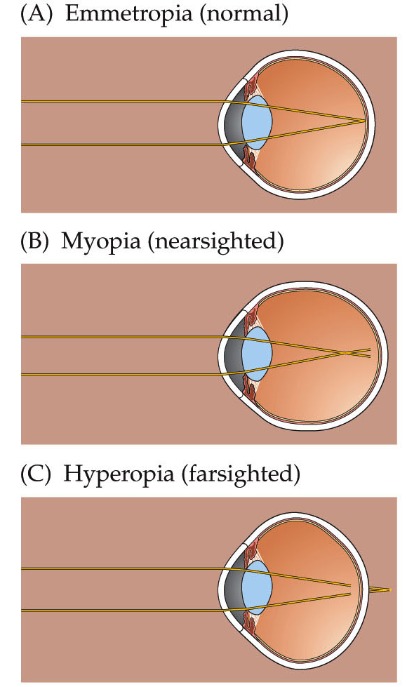
Myopia and Other Refractive Errors
Myopia – nearsightedness
The ability to see close objects clearly but distant objects are blurry
Cornea and lens focus object in front of the retina
Corrected by concave lens (minus lens), radial keratotomy, laser corneal sculpting.
Hyperopia - farsightedness
Ability to see distant objects but close objects are blurry
Image is focused behind the retina.
Corrected by convex lenses.
Notes:
neuro4e-box-11-a(1)-0.jpg

Slide 30
Normal
Myopia – nearsightedness
Hyperopia - farsightedness

Slide 31
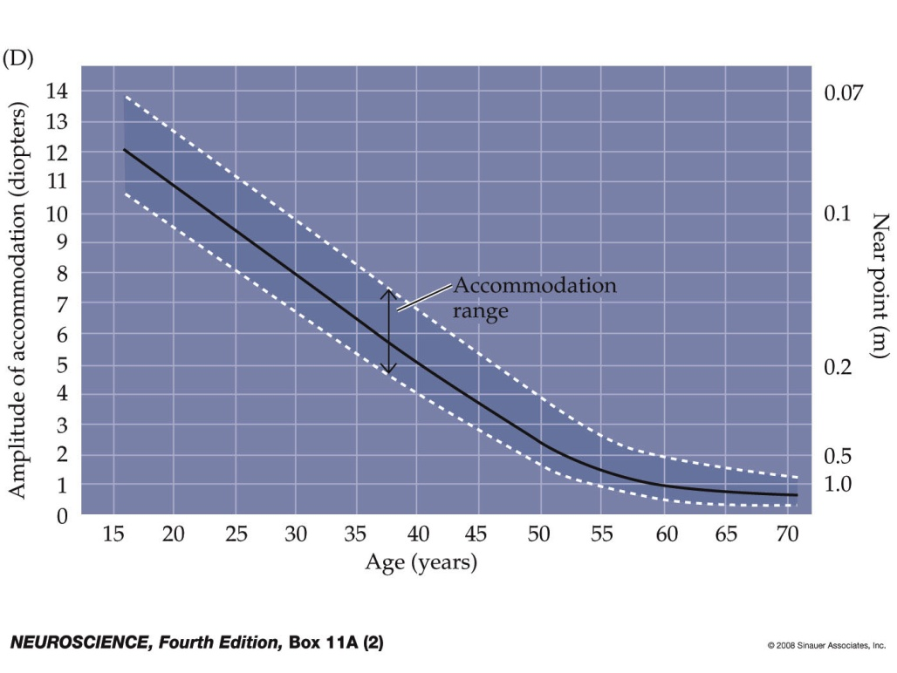
Myopia and Other Refractive Errors
Presbyopia - degeneration of accommodation
Lens becomes less flexible with age probably because new cells are being generated but old ones are not being destroyed.
Near point of vision has increased past 9 inches
Generally develops after 40 years or in people who do fine, close work.
What is your near point of vision?
Corrected by “reading glasses” or bifocal glasses used only for close work.
Notes:
neuro4e-box-11-a(2)-0.jpg

Slide 32
Question 223.18.4
What is the power (in Diopters) of a lens with a focal distance of 0.5m?
5
4
3
2
1

Slide 33
532THz (red)
562THz (green)
714THz (blue)
Relative Sensitivity
Frequency

Slide 34
Relative Sensitivity
(red)
(green)
(blue)
Frequency

